Slide 1

SnipGold and Tahltan Central Government
Collaboration
Reclamation of the Former
Johnny Mountain Mine
*Elizabeth Fillatre Miller, M.Sc., R.P.Bio
Kevin Hidber, AScT
Jessy Chaplin, M.Sc., R.P.Bio
Mike Skurski, P.E.
R. Brent Murphy, MSc., P.Geo (NWT)
*Nalaine Morin, BASC, EP
Notes:
Team-
1

Slide 2
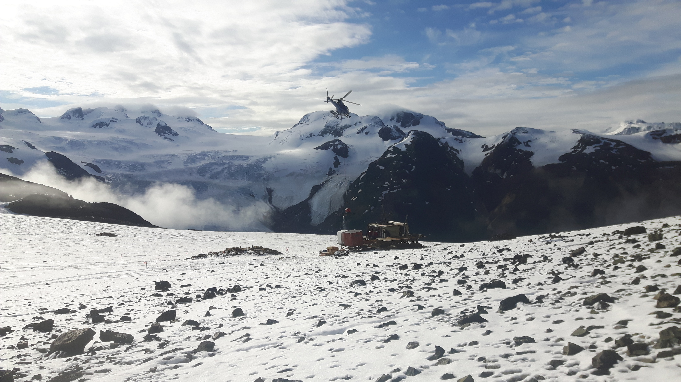
About Seabridge Gold
Notes:
Seabridge Gold is a Canadian-based resource exploration company. Seabridge Gold has 100% ownership of the KSM Property, held by KSM Mining ULC, as well as the Courageous Lake Project in the Northwest Territories and Snowstorm in Nevada. Offices in Smithers and Toronto. SnipGold is a subsidiary of Seabridge Gold.

Slide 3
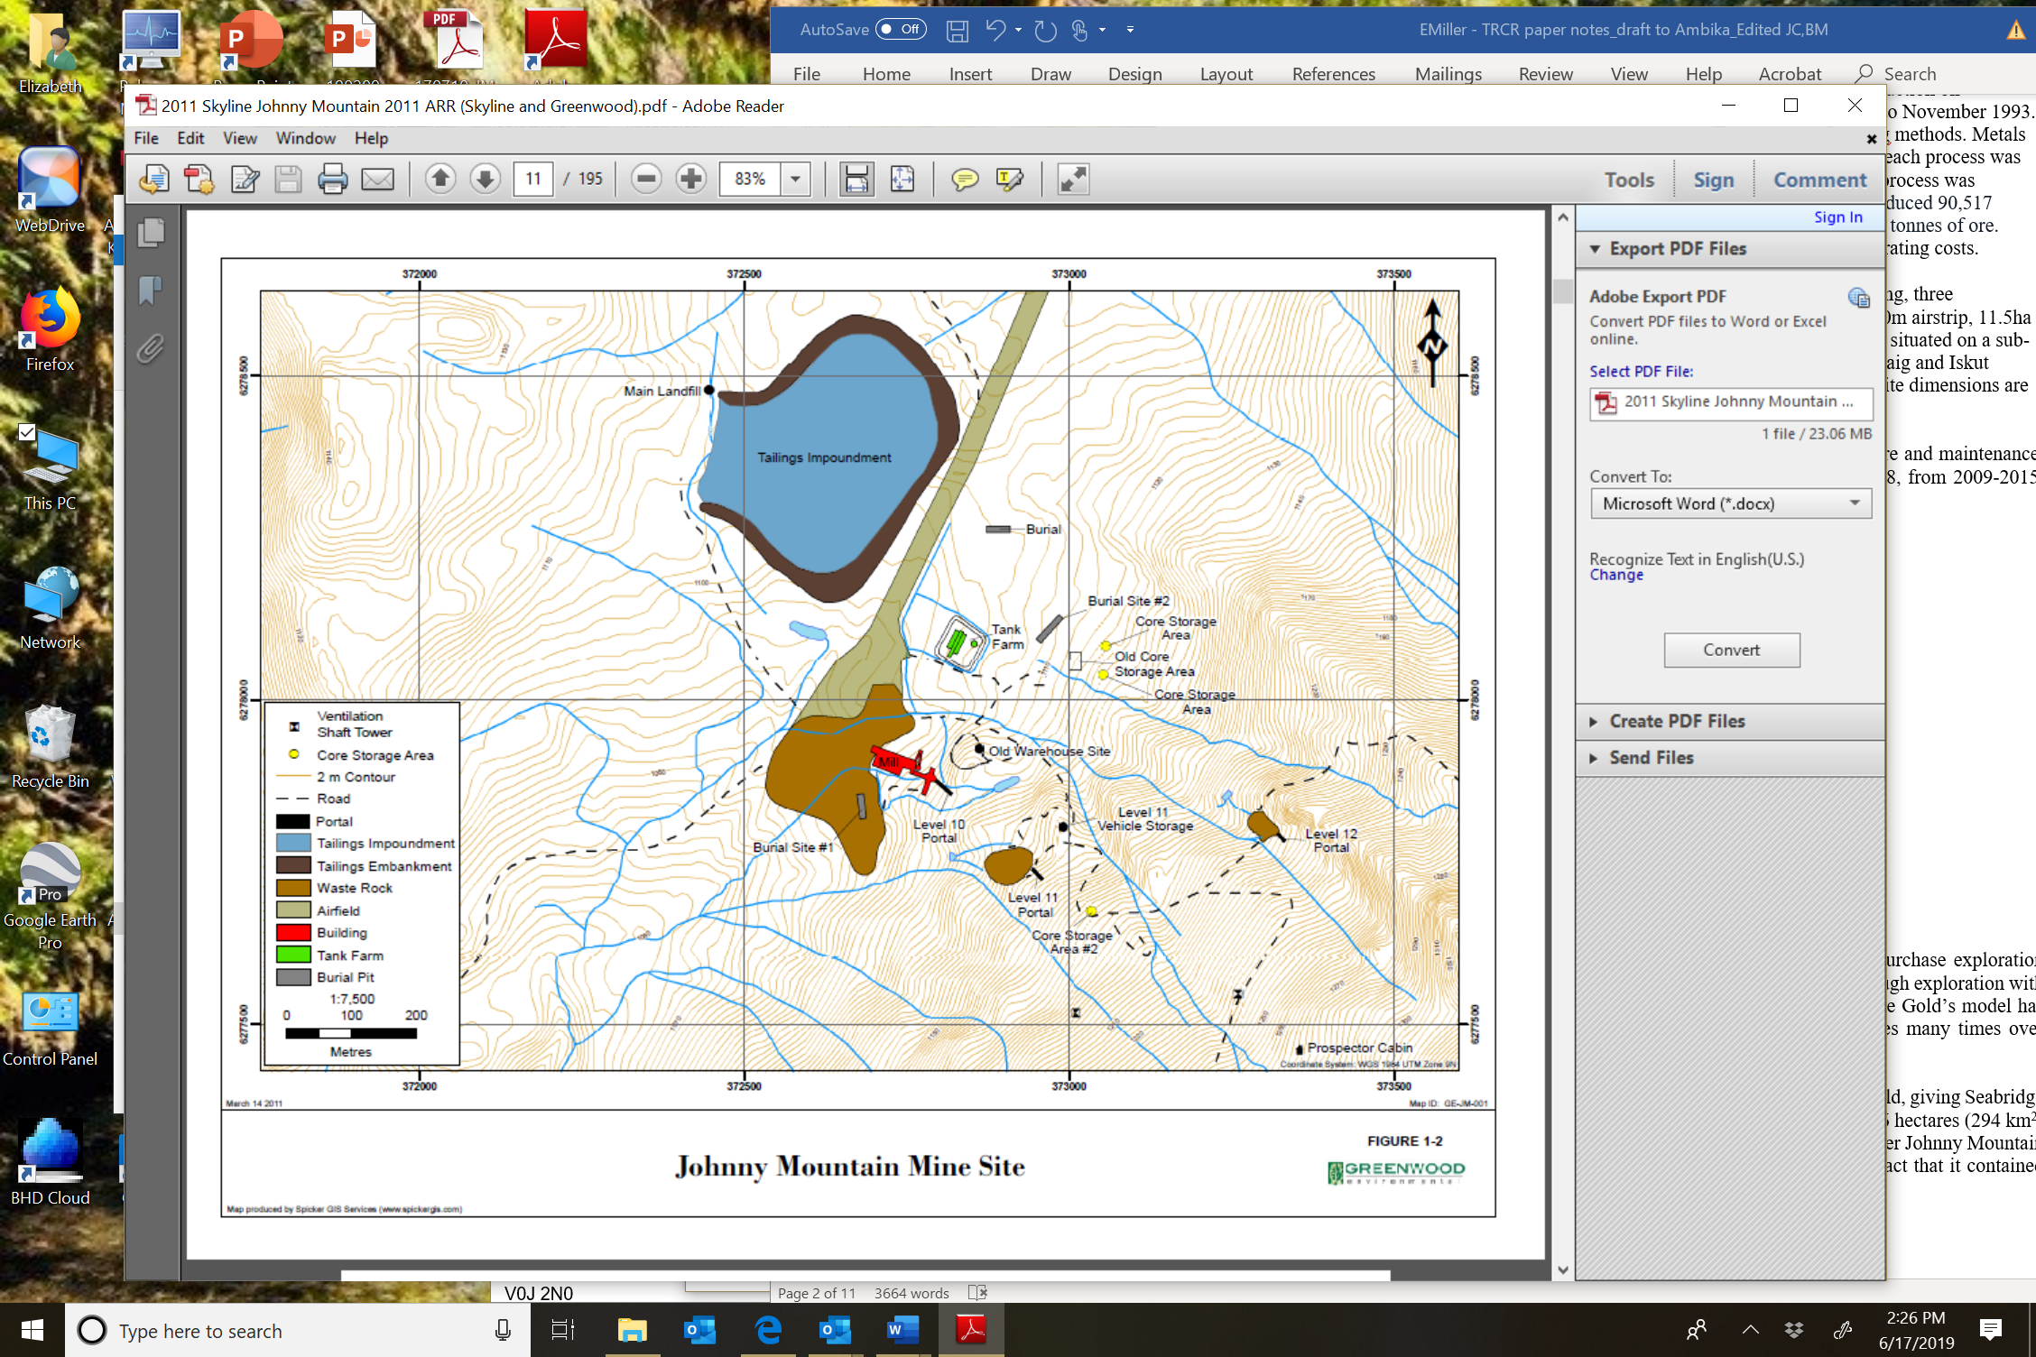
Former Johnny Mountain Mine (JMM) Site
Former underground gold mine located in BC’s Golden Triangle within Tahltan Territory
Commercial production:
  November 1988 until September 1990
  Brief re-opening from September to November 1993
  In 1993, JMM ceased operations due to low gold prices and high operating costs.
Produced:
  90,517 ounces of gold;
  19,818 ounces of silver
  2,222,477 pounds of copper
Notes:
Ceased operations in 1993 due to low gold prices and high operating costs.
Situated on a sub-alpine plateau surrounded by steep valleys and is located near the Craig and Iskut Rivers.
Challenges- short work season, no road access, old and limited equipment (D8, CAT 235 and 316) Positives- good working relationship with Tahltan Nation, dedicated team, synergies with SEA exploration program and KSM program.

Slide 4
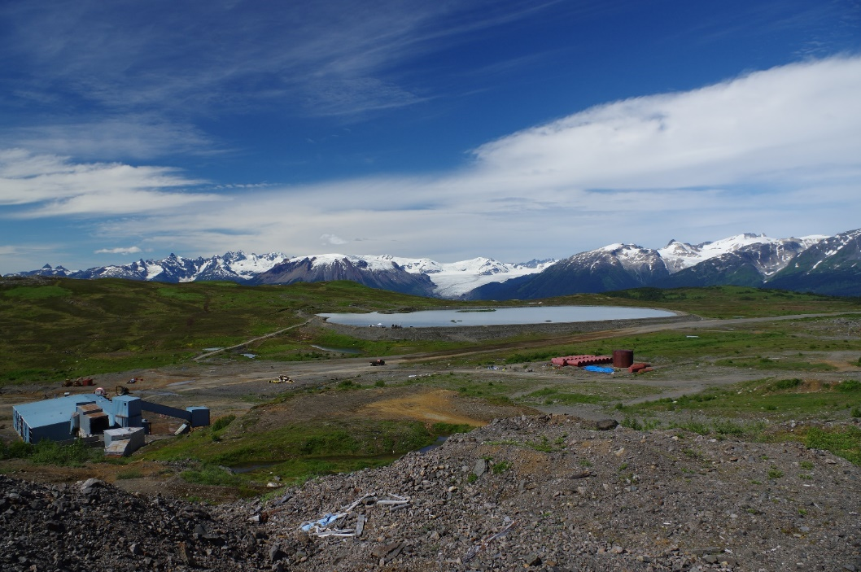
SnipGold Corporation
Between 1993 to 2016 JMM was owned by Skyline Gold and later SnipGold, who last held the property in care and maintenance
SnipGold Corp. was purchased by Seabridge Gold in 2016.
SnipGold reaffirmed the commitment to continue exploration drilling on the property and reclaiming the JMM site by correcting the historic mining legacy
Overall reclamation objectives for the JMM site is to show tangible yearly progress in reclaiming the site back to its original pre-mine conditions
  SnipGold technical team, working in conjunction with the Tahltan Nation.
.

Slide 5
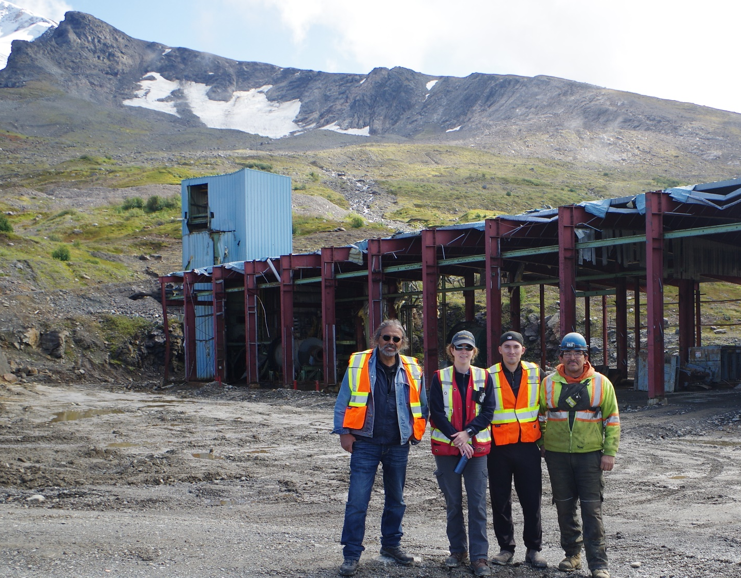
Tahltan Central Government
The JMM is located within Tahltan Territory.
The Tahltan Central Government (TCG) is the administrative governing body of the Tahltan Nation.
TCG is responsible for the ecosystem and natural resources of Tahltan Territory, for managing sustainable economic development, and for strengthening the cultural wellness of the Tahltan Nation.
The TCG created THREAT in 2005 to provide project management and technical support
Notes:
Nalaine to present? Slides 5-10

Slide 6
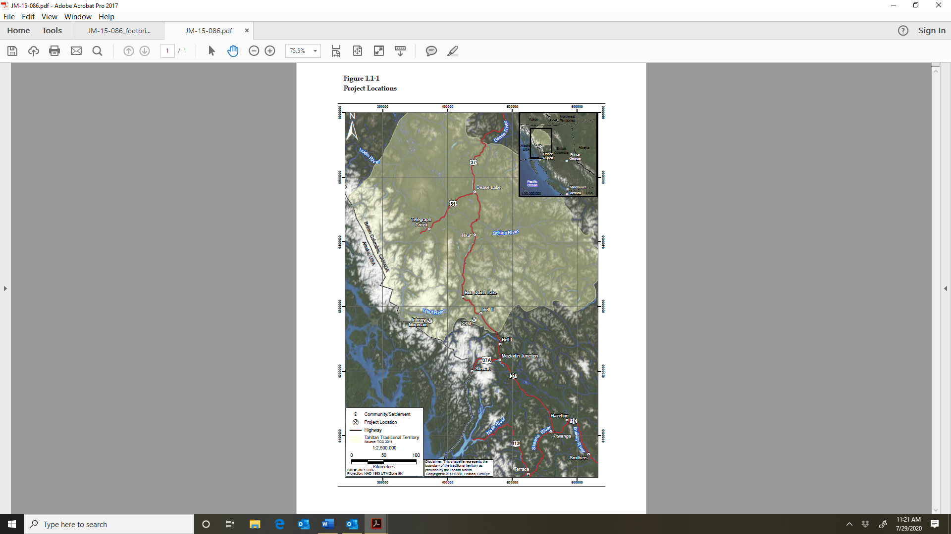
Tahltan Territory & Land Use
Tahltan territory is located in northern BC and extends into the Yukon. It is approximately 95,933 km2
The Tahltan population has approximately 4,000 members with about 800 members living in Tahltan territory.
Known for its mineral resources there is an extensive mining history dating back thousands of years to when Tahltan people mined obsidian from Mt Edziza.
The Tahltan Nation has three communities: Telegraph Creek, Iskut, and Dease Lake
Tahltan people believe they have an inherent responsibility to steward Tahltan lands and the many values it provides
Notes:
Tahltan territory goes from the mouth of the Iskut River in the south to the Rancheria River in the Yukon, from the eastern slopes of the Coastal Mountains in the west to the headwaters of the Stikine and the upper half of the Turnagain River in the east.

Slide 7
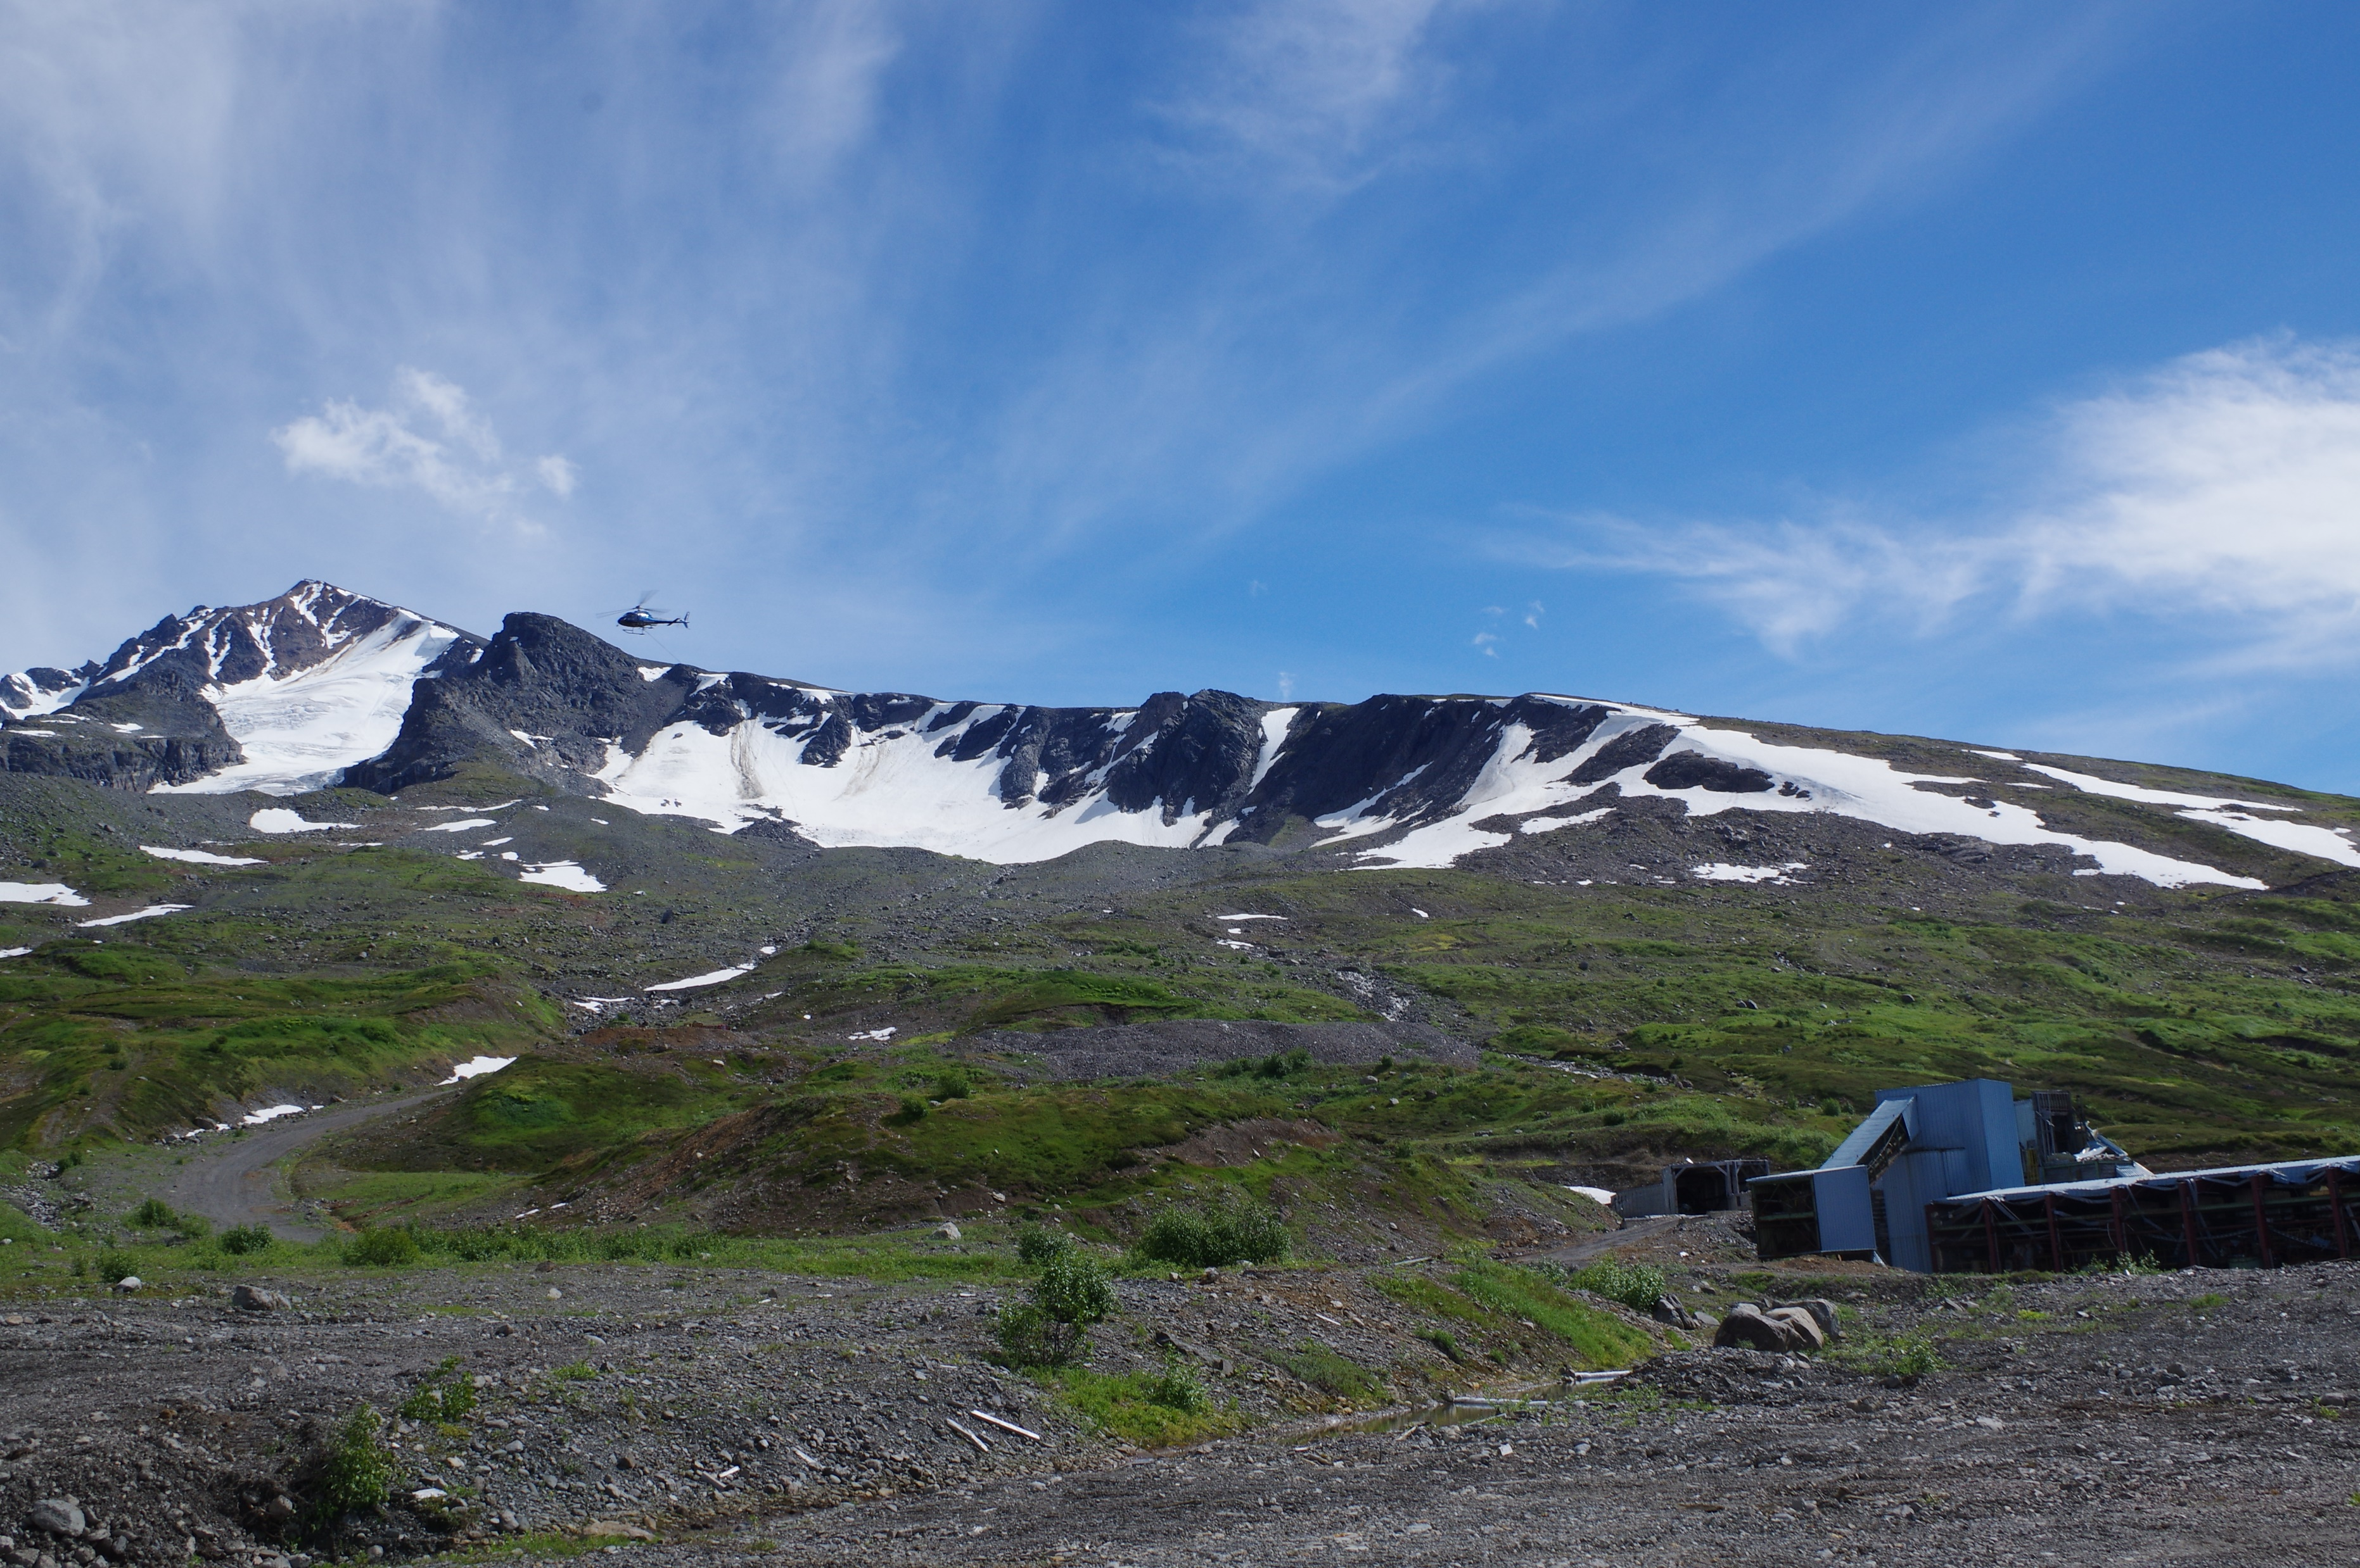
Tahltan Governance
The TCG has several departments including the Lands, Wildlife, Fisheries and Culture and Heritage that support the TCG’s responsibilities to ecosystem and natural resource management.
The Lands department works closely with THREAT, who provides technical support to the departments for referrals and major project reviews
THREAT was actively engaged in review process for the KSM project’s environmental assessment application prior to its approval in 2014
THREAT worked with Seabridge in the development of mitigation measures to address Tahltan concerns and potential impacts to Tahltan rights and interests.
Notes:
Tahltan title and rights includes the development and implementation of systems that uphold TCG’s responsibilities to ecosystem and natural resource management, supporting and developing a sustainable economy and strengthening the cultural wellness of the Tahltan Nation.

Slide 8
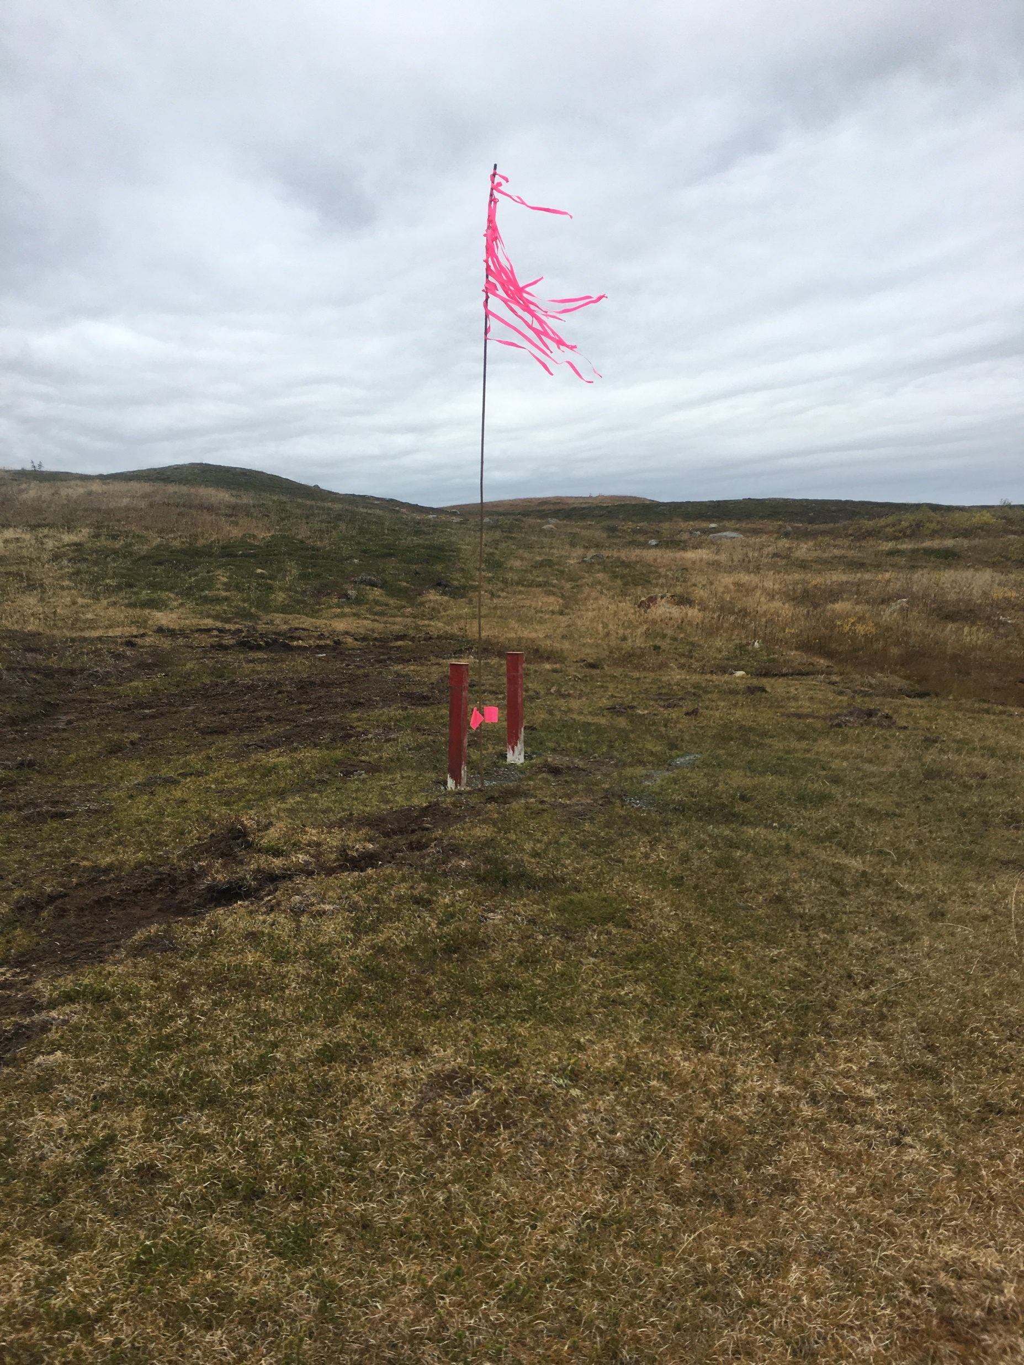
Tahltan Governance
Tahltan Ancestral Study project captures and preserve Tahltan knowledge of the land
Oral interviews compiled in GIS database is used by Tahltan government to support studies, planning and decision-making discussions for resource development projects in Tahltan territory.
Tahltan land use and occupancy studies are developed by the Tahltan Heritage Resources Environmental Assessment Team (THREAT) with environmental baseline studies for natural resource projects in Tahltan territory.
Notes:
Tahltan territory goes from the mouth of the Iskut River in the south to the Rancheria River in the Yukon, from the eastern slopes of the Coastal Mountains in the west to the headwaters of the Stikine and the upper half of the Turnagain River in the east.

Slide 9
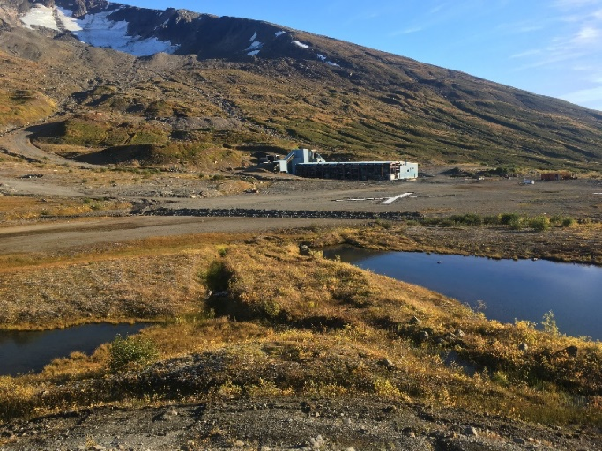
Tahltan Governance
The TCG is endorsed and supported by the Tahltan Band and the Iskut Band. The bands are responsible to govern their community’s interests in respect of the Indian Act.
The Tahltan Nation Development Corporation (TNDC) is the business arm of the Tahltan Nation created to provide employment, training and contracting opportunities to Tahltan members
Notes:
Tahltan title and rights includes the development and implementation of systems that uphold TCG’s responsibilities to ecosystem and natural resource management, supporting and developing a sustainable economy and strengthening the cultural wellness of the Tahltan Nation.

Slide 10
Historical Reclamation Issues at JMM
350 tonnes per day mill building
Three underground portals with associated waste rock portal pads
Five vent raises
Fuel tank farm
1,600m airstrip
11.5ha tailings impoundment facility
Landfill
Miscellaneous unapproved debris dumps
JMM Site Layout when the property was acquired in 2016
Notes:
When the project was acquired by Seabridge Gold in 2016- the infrastructure at site included.

Slide 11
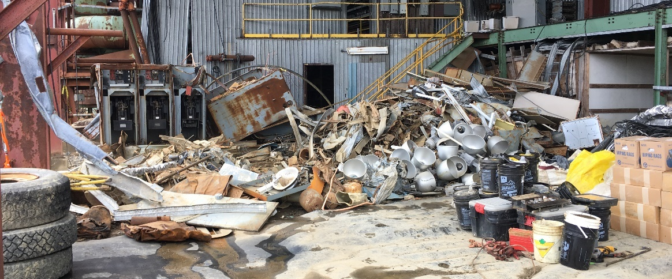
Historical Reclamation Issues at JMM – Mill Building
Notes:
Downside- historical issues at JMM- Previous owners did not have enough funds to reclaim mine site.

Slide 12
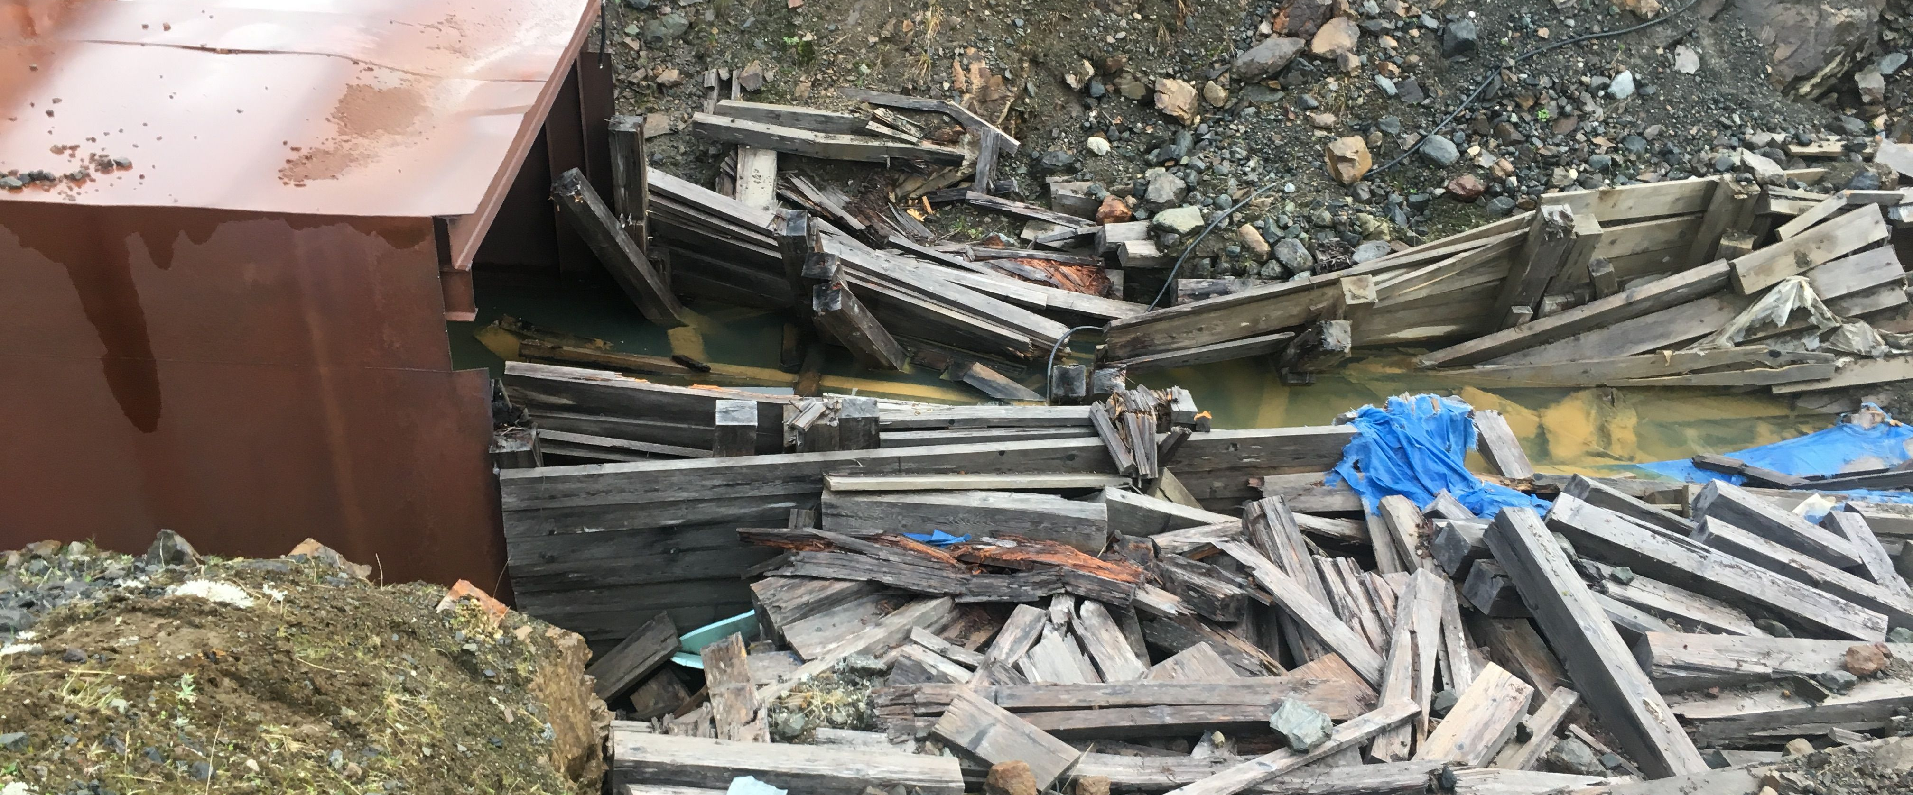
Historical Reclamation Issues at JMM – Portal and Vents

Slide 13
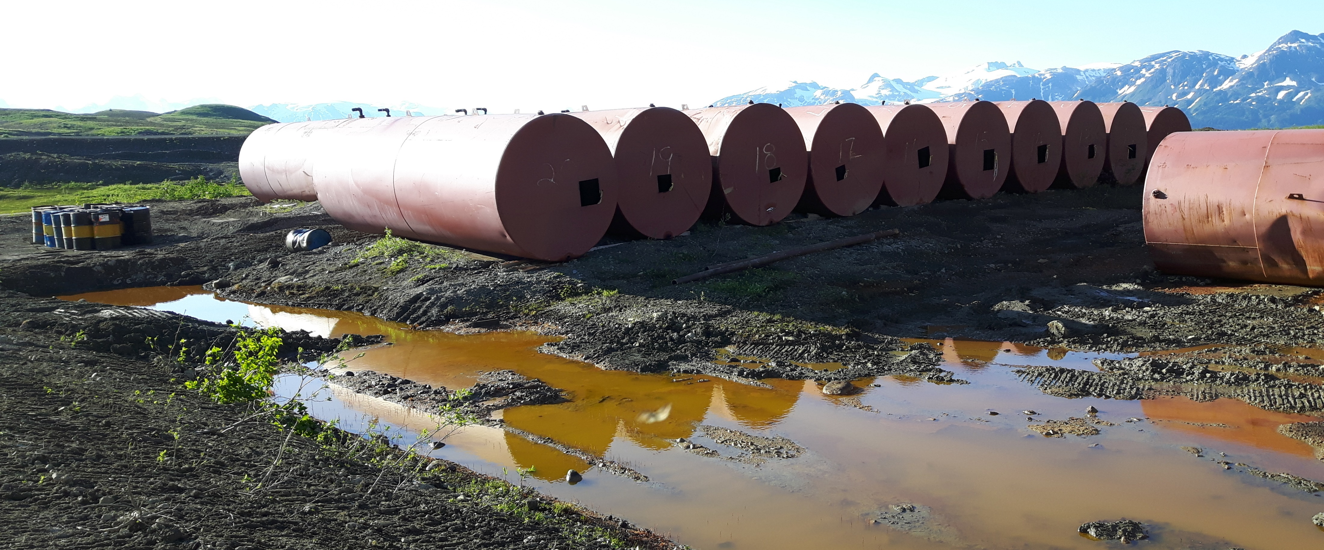
Historical Reclamation Issues at JMM – Tank Farm
Notes:
Landfill and TMF

Slide 14
Tahltan Nation and Seabridge Gold
Began developing a relationship through exploration and working together on acquiring an environmental assessment certificate for the KSM project
Seabridge and the TCG established processes early in the KSM Project exploration phase to support ongoing communications with the Tahltan leadership and the communities.
Seabridge provided financial capacity funding for THREAT to fully participate in the Environmental Assessment process, and Seabridge provided financial negotiations support for the IBA.
Signed a Cooperation and Benefits Agreement in 2019 with regards to the KSM Project
Notes:
Nalaine to present Slides 19-22

Slide 15
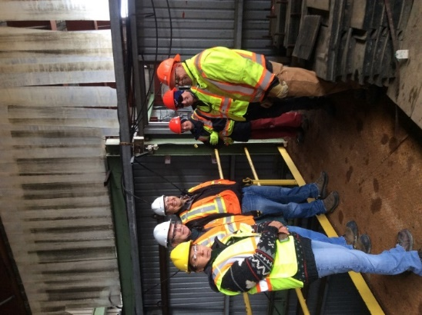
Tahltan Nation and SnipGold Engagement and Collaboration
Informed TCG President of Seabridge’s acquisition of SnipGold directly from Seabridge’s company president as soon as possible
Made commitment to reclaim the historic JMM in cooperation with the Tahltan Nation
Committed approximate $C8 million for reclamation activities
Signed agreements including Communication Agreement and Opportunity Sharing Agreement
  Outlines operational expectations, engagement and dispute resolution processes, annual planning, hiring and contract opportunities.

Slide 16
Tahltan Nation and SnipGold Engagement and Collaboration
“SnipGold has demonstrated clear and transparent intentions of addressing historic mining activities at the former Johnny Mountain Mine site, located in Tahltan Territory. We are pleased to work with them collaboratively to support and further the reclamation programs at the site by providing services through Tahltan businesses and people. We are pleased that SnipGold is addressing this historic issue and look forward to this continued relationship with SnipGold.“
Chad Day
President of Tahltan Central Government
Government Regulators and Tahltan Nation Communication
xx

Slide 17
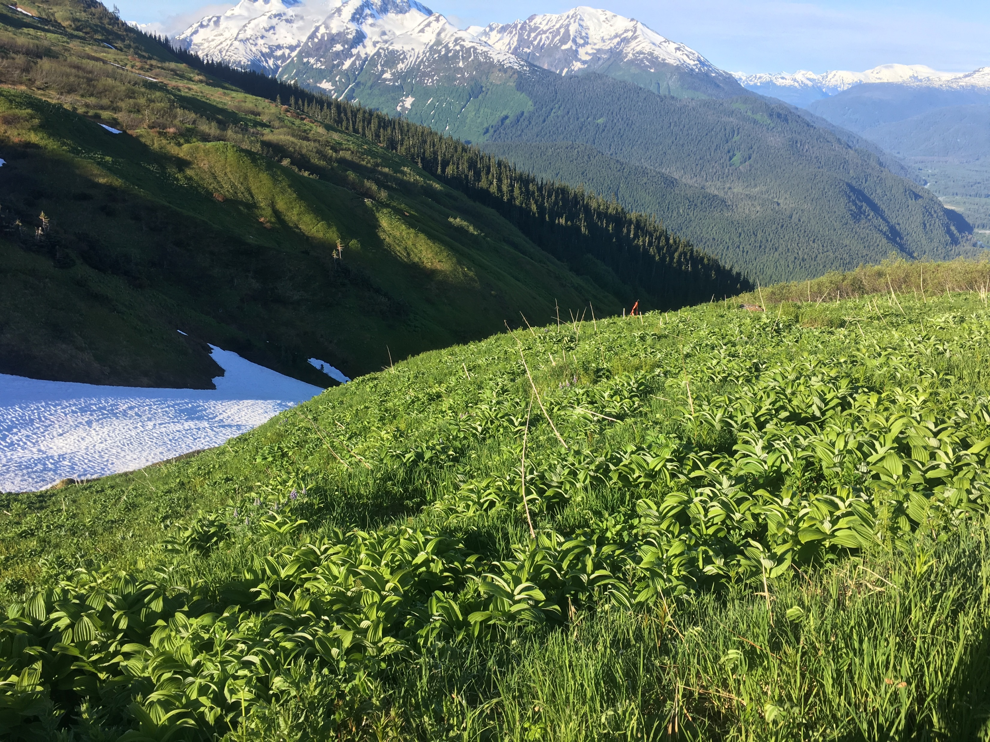
Tahltan Nation and SnipGold Engagement and Collaboration
In 2017, developed a five-year JMM Project Execution Plan (PEP) for reclamation activities
TNDC and THREAT are involved in the review and comment of the PEP on an annual basis as progress is measured and additional information is added to the project databank and reclamation progress.
THREAT/TCG review and provide input on planned permit applications before they are submitted to the BC regulatory agencies
THREAT is included in regulatory permit reviews and update meetings.
Ecological Risk Assessment being completed at JMM to support and inform mine reclamation and closure efforts.

Slide 18
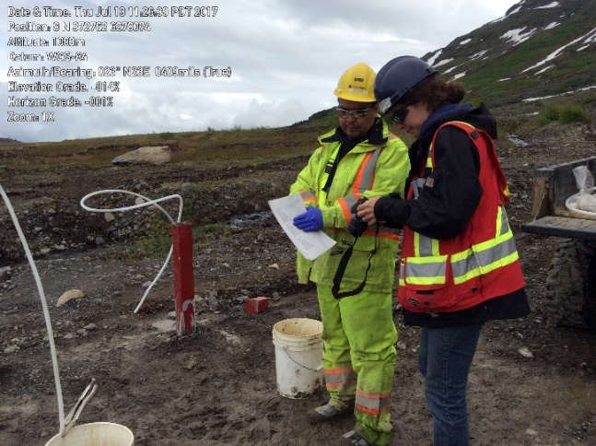
Challenges and Success - Environmental monitoring
Collected environmental data, to understand current groundwater, surface water and soil conditions
52 groundwater monitoring wells
53 test pits were excavated by TNDC employees
Conducted comprehensive aquatic characterization studies to characterize and monitor site conditions during reclamation and closure activities.
  Parameters include data on surface water quality, aquatic life, fish and hydrology both close to the mine and in receiving environments.
Notes:
A network of groundwater monitoring wells, 52 in total, were installed to understand if and where water and soil contamination existed and whether this was translated to three tributary streams leading from the mine site.
Test pits were excavated by TNDC employees to further identify and quantify the extent of soil contamination around the site, with specific focus on the fuel tank farm, mill building and Portal 11 pad.
Env. Data used to focus reclamation efforts

Slide 19
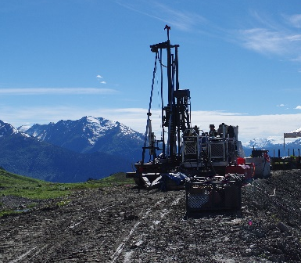
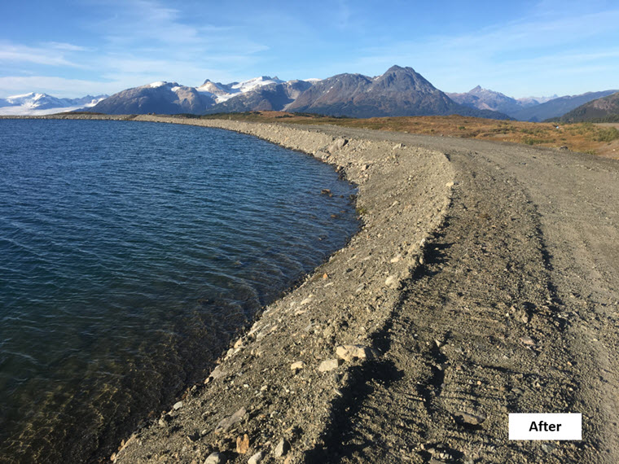
Challenges and Success – Tailings Storage Facility
Installed five vibrating wire piezometers to establish and monitor pore water pressure within the tailings dam embankments
Cosmetic wear and tear such as erosion at the water line of the water cover was repaired
Removal of old equipment from the dam crest was accomplished by TNDC employees with oversight from the Engineer of Record at Klohn Crippen Berger
Safety of the impoundment and environment are shared core values of TCG and SnipGold

Slide 20
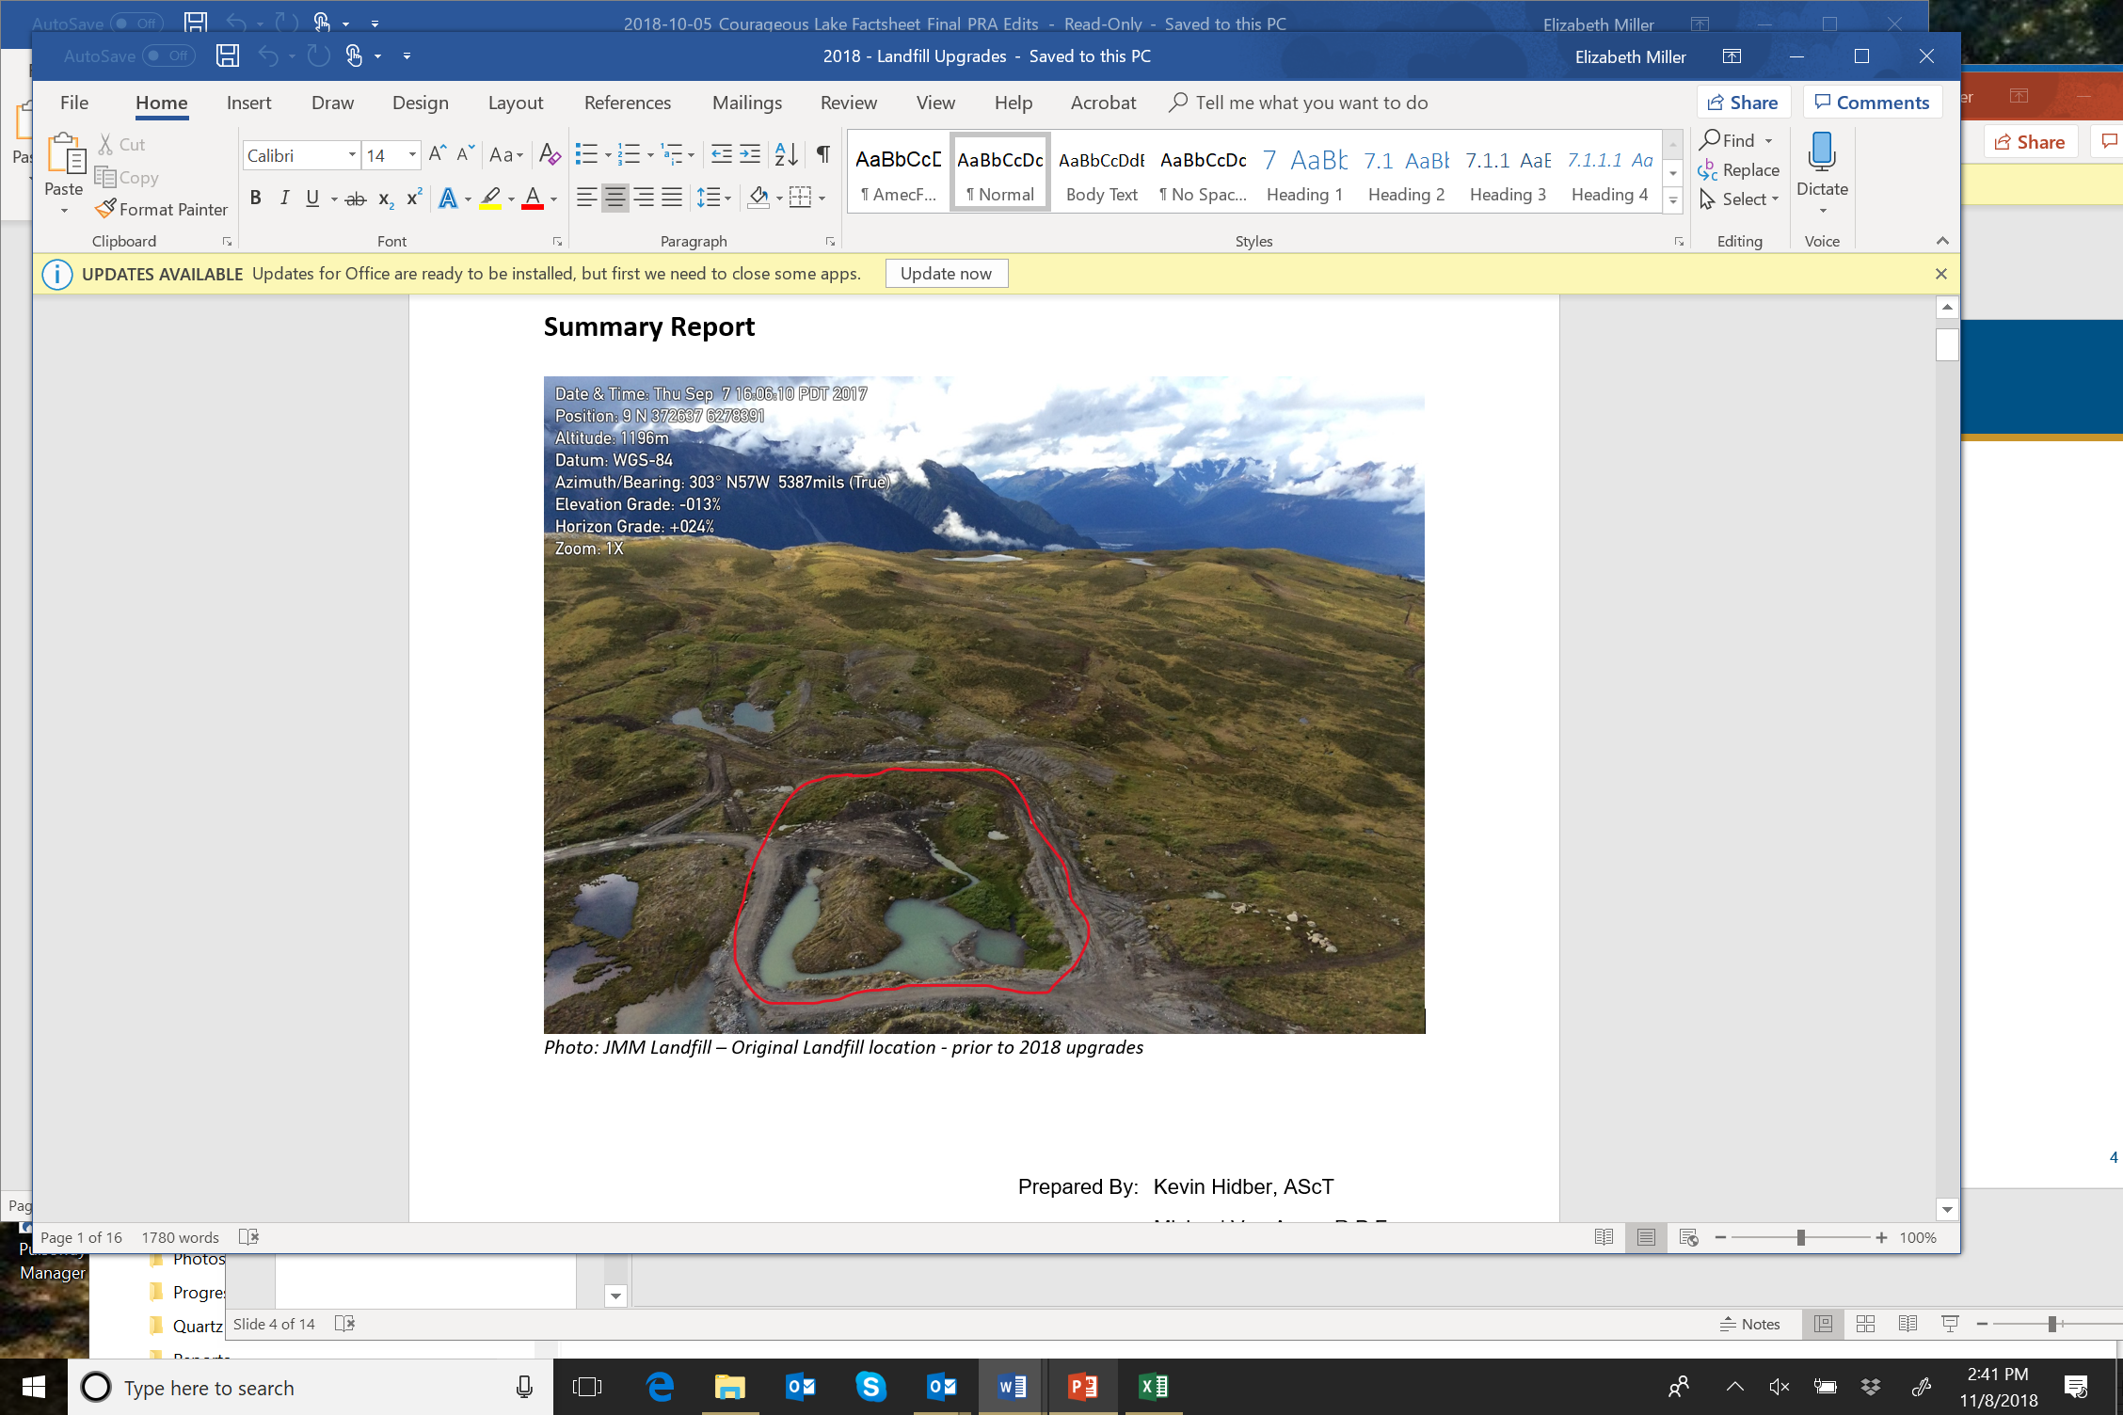
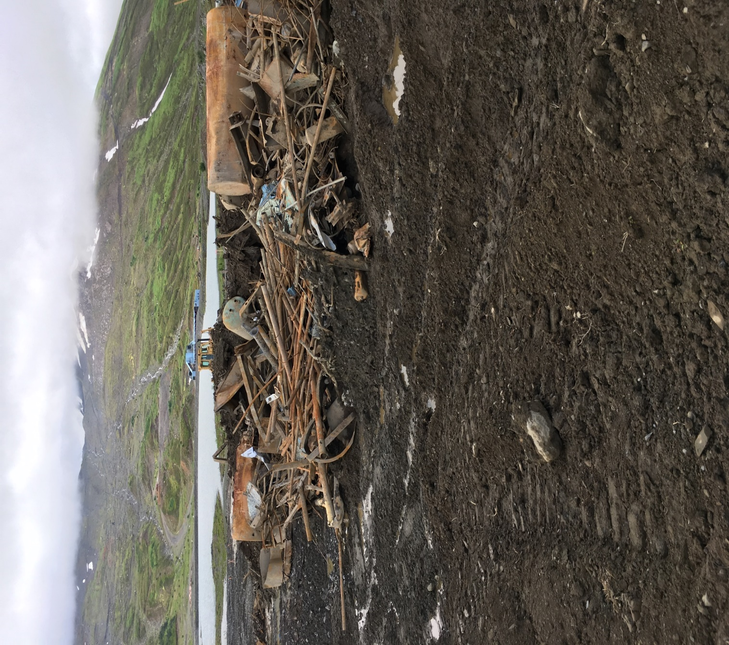
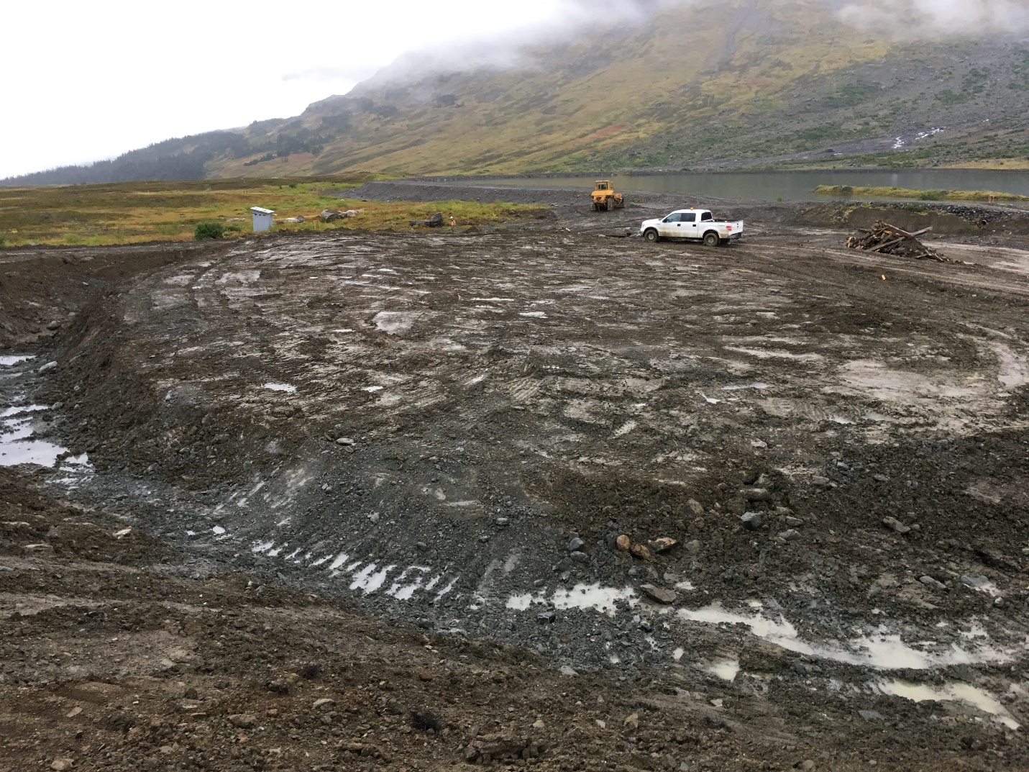
Challenges and Success – Landfill and Landfill Waste
Applied to amend the Ministry of Environmental and Climate Change Strategy (ECCS) landfill permit for JMM to construct a larger landfill and to bring the existing landfill up to required standards.
In 2017, excavated and relocated previously identified historic unapproved landfill sites to the approved landfill
Identified five additional undocumented landfills
By 2018, all inert solid wastes were placed into the JMM Landfill by TNDC employees with oversight from NW Fuel Response.
Before
In progress
After
Notes:
A network of groundwater monitoring wells, 52 in total, were installed to understand if and where water and soil contamination existed and whether this was translated to three tributary streams leading from the mine site.
Test pits were excavated by TNDC employees to further identify and quantify the extent of soil contamination around the site, with specific focus on the fuel tank farm, mill building and Portal 11 pad.

Slide 21
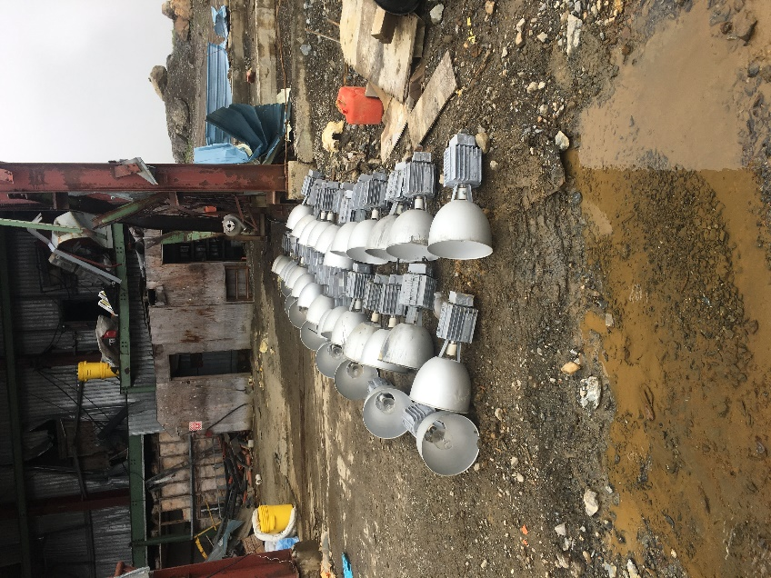
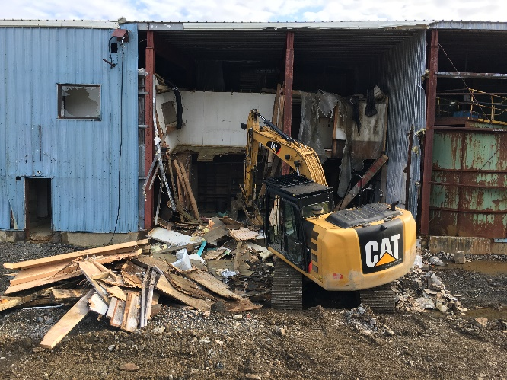
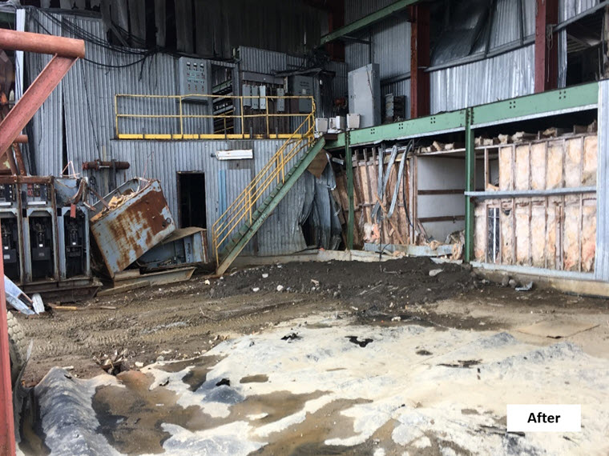
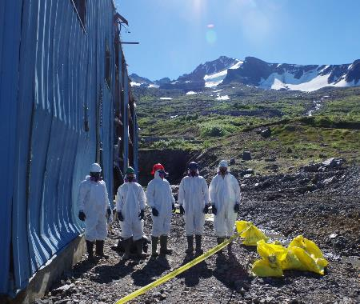
Challenges and Success – Mill and Mobile Equipment Cleanup
Removed tanks, conveyors, pumps, wood timbers, non-load bearing steel structural members and exterior metal cladding from the mill building
  Inert waste was placed in the landfill
  All hydrocarbons and hazardous waste were collected and stored for future offsite disposal
  Sent for offsite disposal:
    4150lbs of asbestos tiles; 38 Mercury vapour bulbs; 14 Batteries and 48 liquids
Mill building shell is currently used for storage of mobile equipment used for reclamation activity and will be demolished in the future
Work was completed by TNDC employees and Tahltech AllNorth, a Tahltan Joint Venture company.

Slide 22
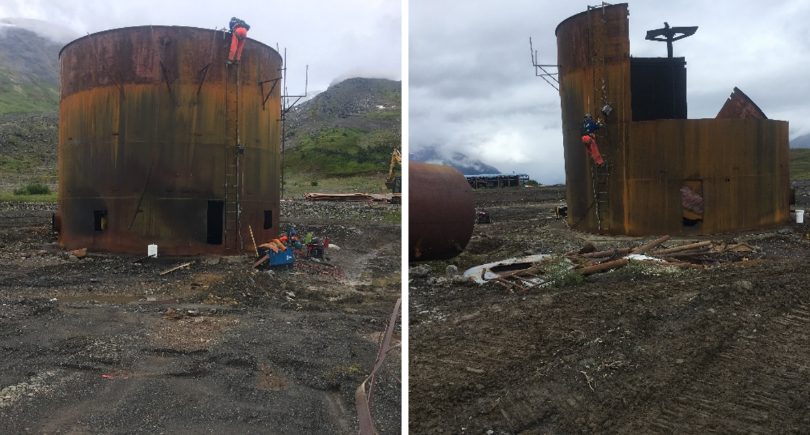
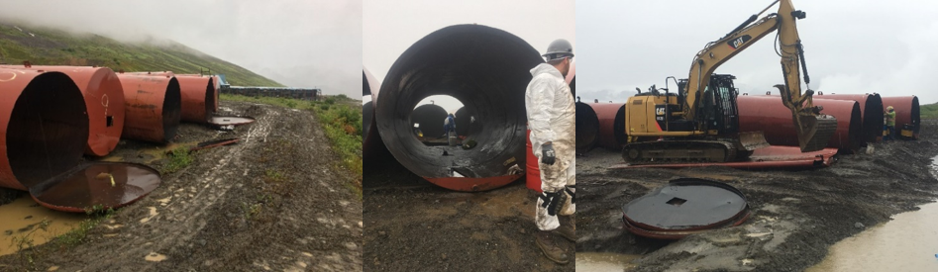
Challenges and Success – Tank Farm Demolition
Fuel farm consisting of twenty-eight fuel storage tanks ranging in size from 7,000 to 100,000-gallon capacity decommissioned in 2017
Progressive Ventures and TNDC conducted the cleaning and flattening of the tanks and placed it into the upgraded landfill
All tasks were conducted following detailed safety planning, by trained and qualified staff with all appropriate personnel protective equipment
100,000 gallons fuel tanks being
demolished from the top down
Large tank partially demolished
Fuel tanks with the ends cut off
Fuel tanks being cleaned
Fuel tanks being crushed with the excavator

Slide 23
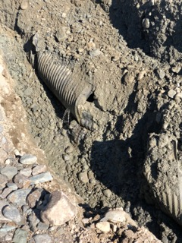
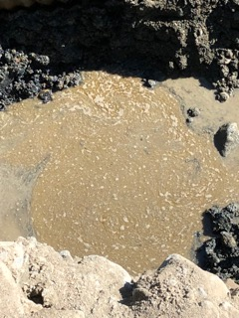
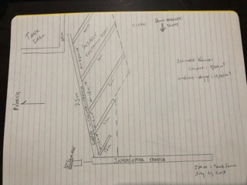
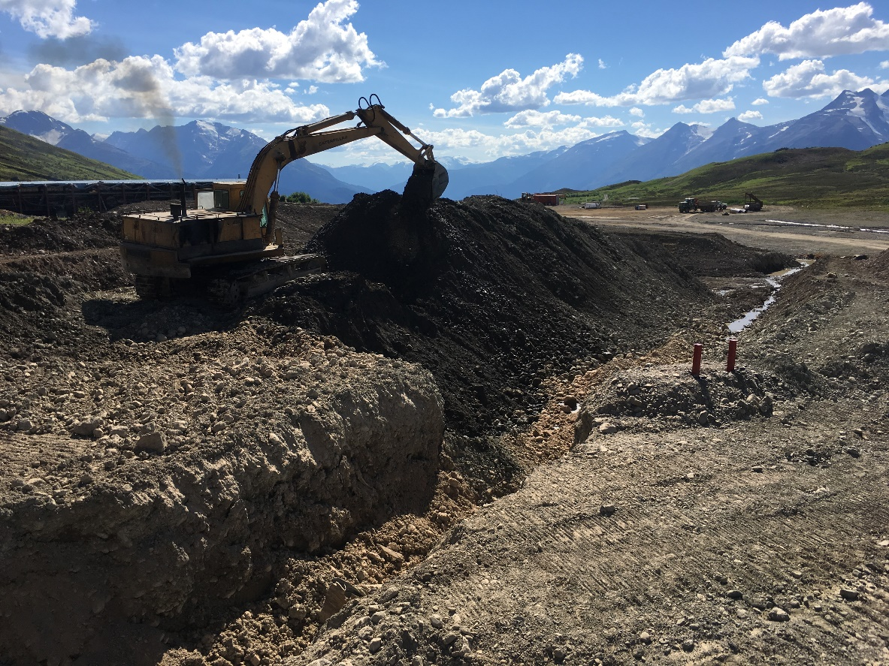
Challenges and Success – In-situ hydrocarbon remediation
Site investigations identified hydrocarbon contaminated soils in and around the tank farm
Approximately 3,000 m³ of contaminated soils were treated by mechanically mixing in a biocatalyst to help accelerate the breakdown of hydrocarbons in the soils.
In 2019, in-situ soil remediation of hydrocarbon contaminated soils continued with an additional 6,000 m³ of contaminated soils treated with a biocatalyst and fertilizer high in nitrogen.
100,000 gallons fuel tanks being
demolished from the top down
Large tank partially demolished
Fuel tanks with the ends cut off
Fuel tanks being cleaned
Fuel tanks being crushed with the excavator
Notes:
Oil Gater

Slide 24
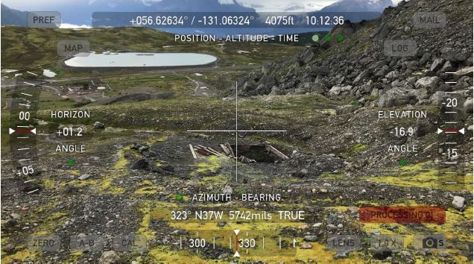
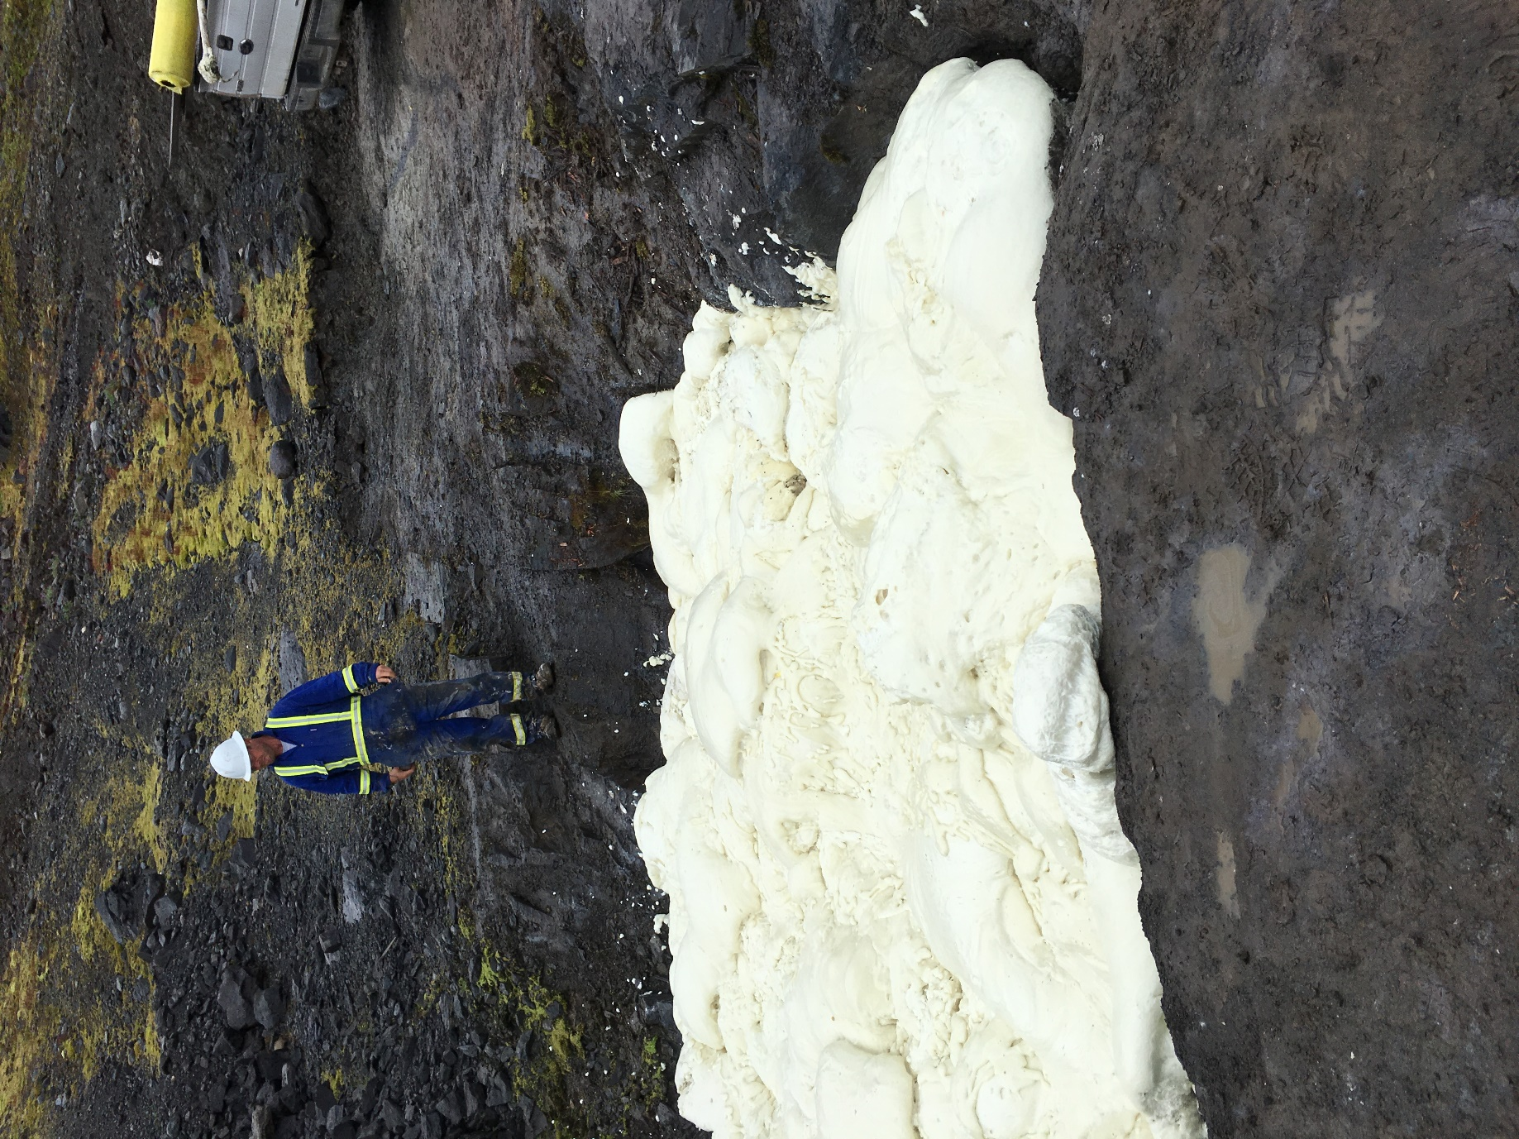
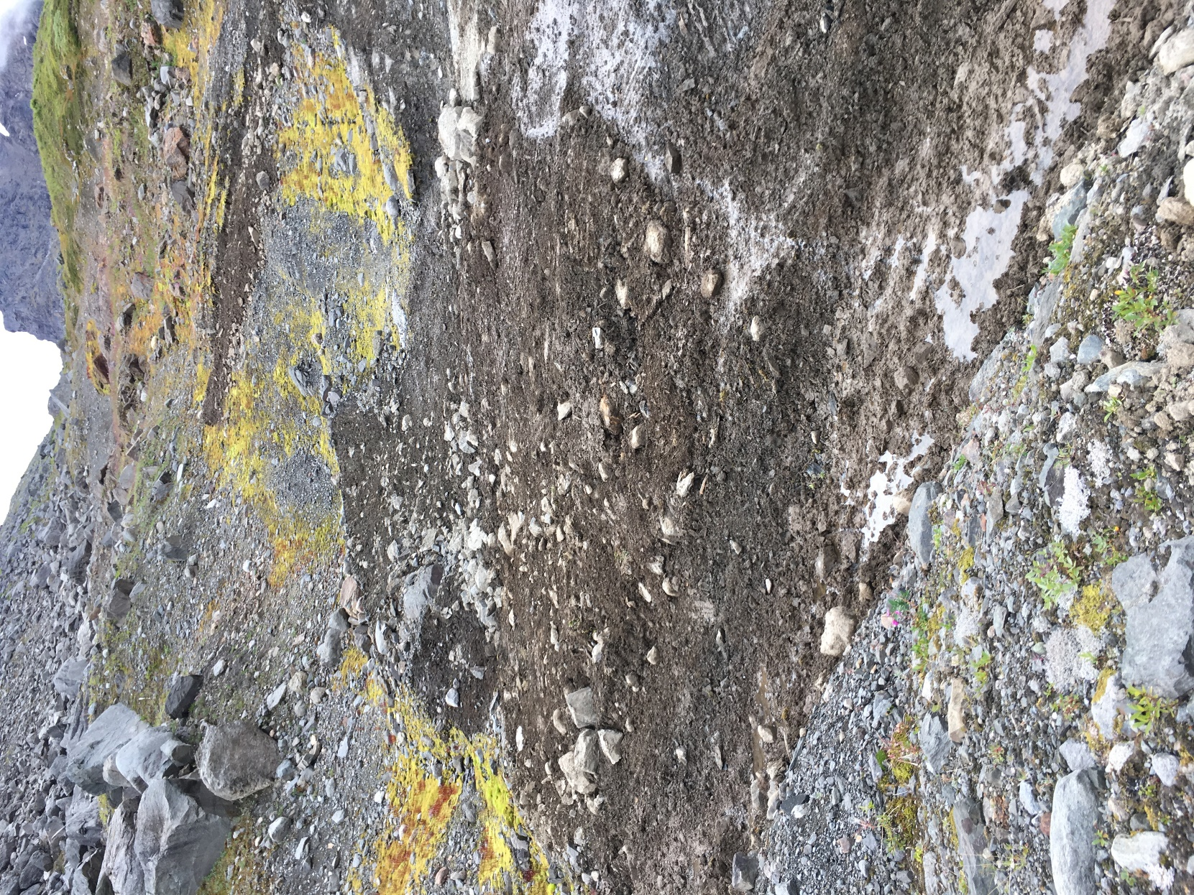
Challenges and Success – Vent Raises
With TNDC support, decommissioned and permanently closed all five vent raises associated with the underground mine by sealing with a polyurethane foam
Covered with native local soils, contoured the area, and revegetated with plants local to the site
Golder Associates provided technical expertise on the closure program with construction support provided by TNDC
Before
100,000 gallons fuel tanks being
demolished from the top down
Large tank partially demolished
During
After
Fuel tanks with the ends cut off
Fuel tanks being cleaned
Fuel tanks being crushed with the excavator
Notes:
Add text on the process of portal closure.

Slide 25
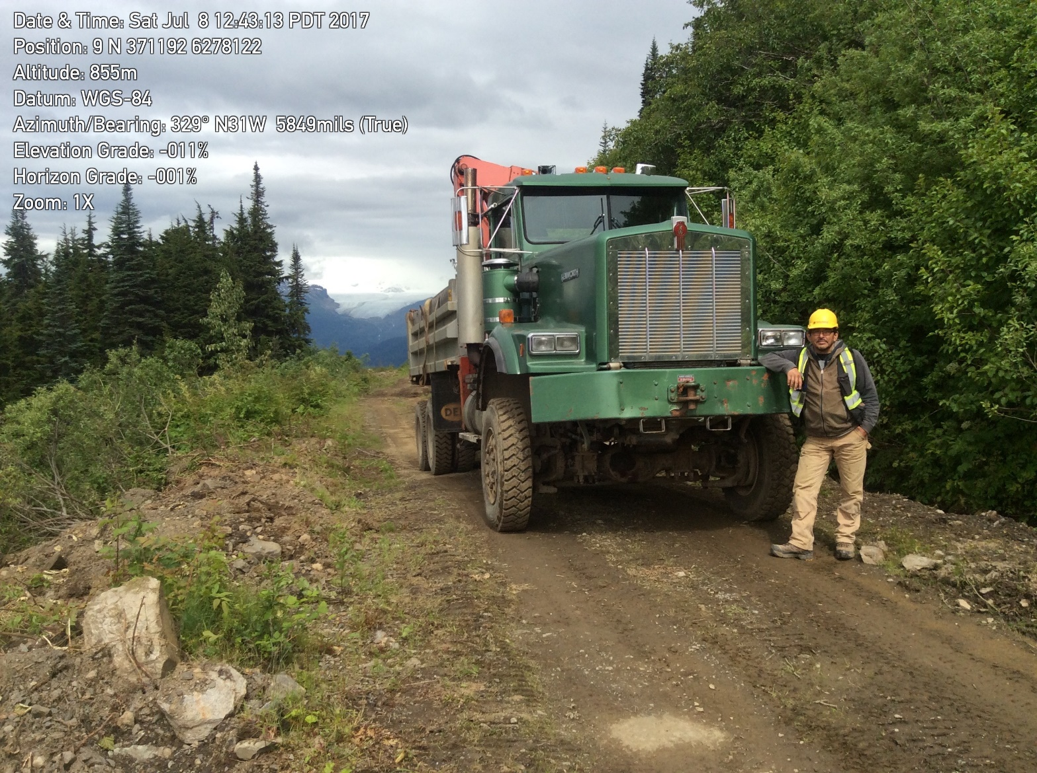
Annual Reclamation Reports
Data collected during the reclamation programs is compiled into Annual Reclamation Reports, submitted to the Ministry of Energy, Mines and Petroleum Resources (MEMPR).
Findings of the annual reports are presented to government regulators with THREAT playing an important role in the process
Project progresses is communicated regularly to TCG, Iskut and Tahltan bands at in-person meetings, community presentations and in various community print forms.
THREAT and TNDC are also involved in pre-planning upcoming field programs.
Large tank partially demolished
Fuel tanks with the ends cut off
Fuel tanks being cleaned
Fuel tanks being crushed with the excavator

Slide 26
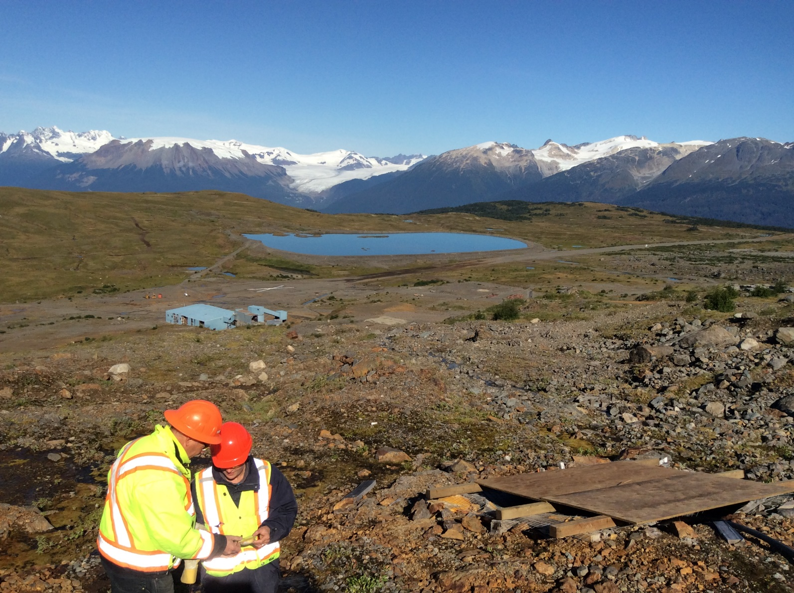
Conclusions
Seabridge and the Tahltan Nation have been successful in their collaborative work to-date on Johnny Mountain reclamation project
  Collaborated through the development of permit applications, reclamation planning and reclamation activities.
Every aspect of the reclamation work included SnipGold and Tahltan employees or contractors, providing a wealth of reclamation knowledge to the Tahltan Nation
This knowledge by TCG, TNDC, THREAT, and the many employees working for these organizations can be used to reclaim and protect Tahltan Territory for generations to come.
Large tank partially demolished
Fuel tanks with the ends cut off
Fuel tanks being cleaned
Fuel tanks being crushed with the excavator

Slide 27
Conclusions
Committed to supporting local communities through investment, training and solid working partnerships for reclamation activities at JMM and future mining activities at the KSM Project.
Majority of this investment paid to BC contractors, Tahltan employees and businesses affiliated with the TNDC for project reclamation activities.
Large tank partially demolished
“A successful partnership built on foundational agreements and built over time has created a successful reclamation project a long-term relationship, illustrating responsible reclamation for the mining community.”
Fuel tanks with the ends cut off
Fuel tanks being cleaned
Fuel tanks being crushed with the excavator

